Slide 1
Fraud Detection Analysis
By :- Rupali Gawate

Slide 2
Introduction:-
Fraud detection is a critical aspect of financial security, aimed at identifying and preventing fraudulent activities across various domains such as banking, insurance, and e-commerce. With the increasing volume of online transactions, fraudulent activities have become more sophisticated, necessitating the use of data-driven techniques for detection.
This project focuses on fraud detection analysis using machine learning and data analytics. The goal is to develop a model that can distinguish between genuine and fraudulent transactions based on historical data. By leveraging techniques such as data preprocessing, feature engineering, classification algorithms, and anomaly detection, the project aims to enhance fraud detection accuracy while minimizing false positives.

Slide 3
Objective:
Understand the patterns and characteristics of fraudulent transactions.
Clean, preprocess, and explore the dataset to derive meaningful insights.
Apply machine learning models such as Logistic Regression, Decision
Trees, Random Forest,
or Neural Networks for classification.
Implement anomaly detection techniques to identify outliers and
suspicious activities.
Evaluate model performance using metrics like precision, recall,
F1-score, and ROC-AUC.
Deploy and visualize results using Power BI, Tableau, or dashboards
for real-time monitoring.

Slide 4
Importing necessary libraries:
import os
import pickle
My data has a pickle files so that I have imported the pickle.

Slide 5
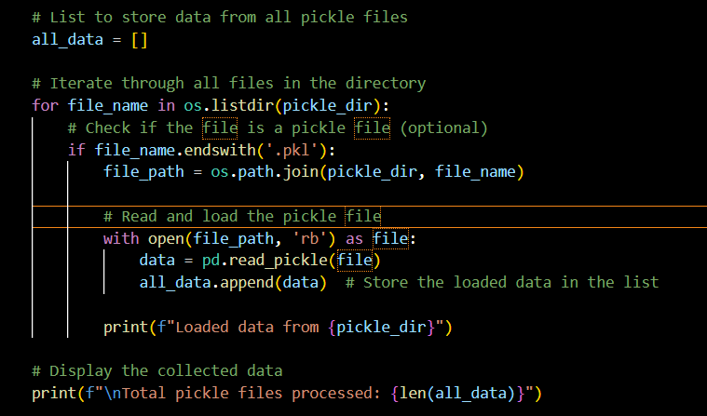
I uses following codes to read the pickle files

Slide 6
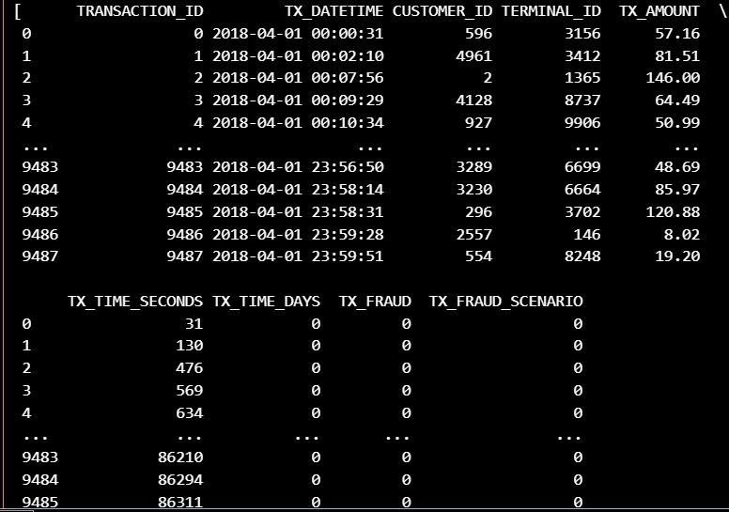
Table content:-

Slide 7
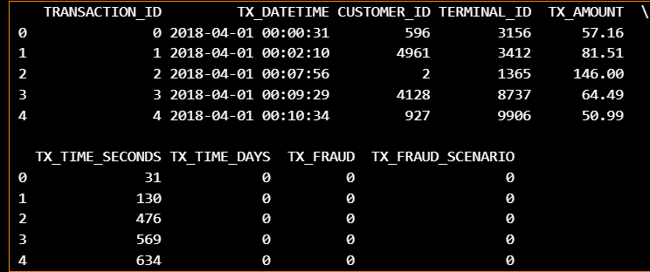
These are the five rows of data available in the dataset

Slide 8
Then I have plot a boxplot to understand data easily
import seaborn as sns
import matplotlib.pyplot as plt
# Fraud distribution
sns.countplot(x=df['TX_FRAUD'])
plt.title("Fraud vs Non-Fraud Transactions")
plt.show()
# Transaction Amount Distribution
sns.boxplot(x=df['TX_FRAUD'], y=df['TX_AMOUNT'])
plt.title("Transaction Amount by Fraud Status")
plt.show()

Slide 9
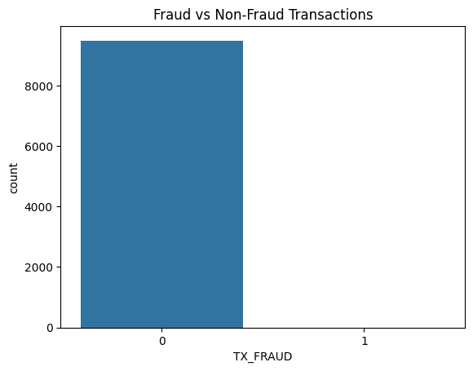
This indicates that the plot is comparing the count of fraudulent and non-fraudulent transactions. The 0 represents non-fraudulent transactions (legitimate transactions). The 1 represents fraudulent transactions (suspicious or illegal transactions).

Slide 10
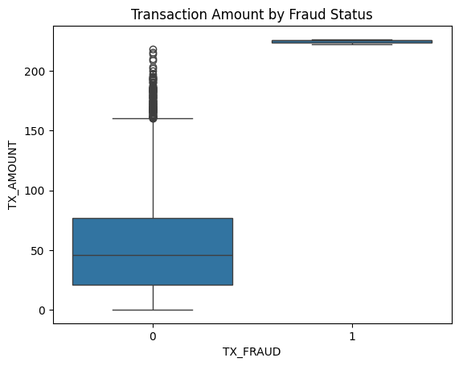
This is a box plot comparing transaction amounts (TX_AMOUNT) for fraudulent (TX_FRAUD = 1) and non-fraudulent (TX_FRAUD = 0) transactions. 1. X-axis (TX_FRAUD): 0 represents non-fraudulent transactions. 1 represents fraudulent transactions. 2. Y-axis (TX_AMOUNT): This represents the transaction amount.

Slide 11
Now importing the Random Forest Classifier
from sklearn.model_selection import train_test_split
from sklearn.ensemble import RandomForestClassifier
from sklearn.metrics import classification_report, accuracy_score
# Split data into train & test sets
X_train, X_test, y_train, y_test = train_test_split(X, y, test_size=0.2, random_state=42, stratify=y)
# Train Random Forest Classifier
model = RandomForestClassifier(n_estimators=100, random_state=42)
model.fit(X_train, y_train)
# Predict on test data
y_pred = model.predict(X_test)
# Model evaluation
print("Accuracy:", accuracy_score(y_test, y_pred))
print(classification_report(y_test, y_pred))

Slide 12
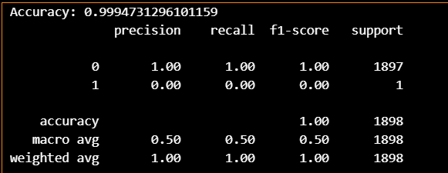
I have the 99% accuracy in random forest classifier

Slide 13

log_reg = LogisticRegression(max_iter=1000, class_weight='balanced') log_reg.fit(X_train, y_train) applying logistic regression we get.

Slide 14
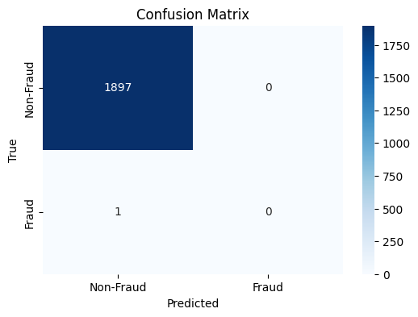
This confusion matrix evaluates the performance of a classification model in detecting fraudulent and non-fraudulent transactions. The model is very good at identifying non-fraudulent transactions (high TN). However, it completely fails to detect fraudulent transactions (0 TP). This suggests severe class imbalance, where the model is biased toward the majority class (Non-Fraud). Precision and Recall for Fraud class are both 0, making the model ineffective for fraud detection

Slide 15
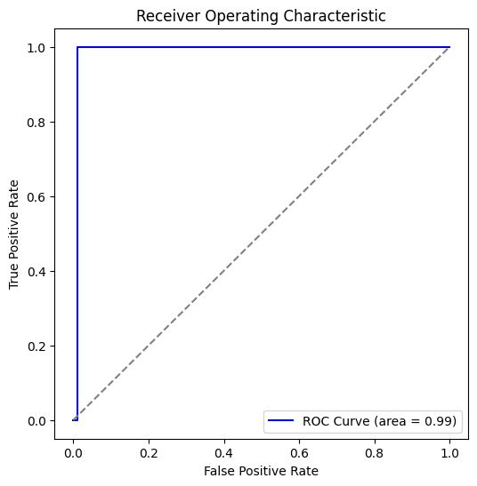
Importing the ROC curve

Slide 16
This plot represents the Receiver Operating Characteristic (ROC) curve, which is used to evaluate the performance of a classification model.
The blue curve represents the performance of your fraud detection model.
The dashed diagonal line represents a random classifier (no predictive power).
The blue line reaches the top-left corner quickly, indicating high sensitivity (recall) and low false positive rate.
The Area Under the Curve (AUC) = 0.99, which is very high, suggesting an excellent model.

Slide 17
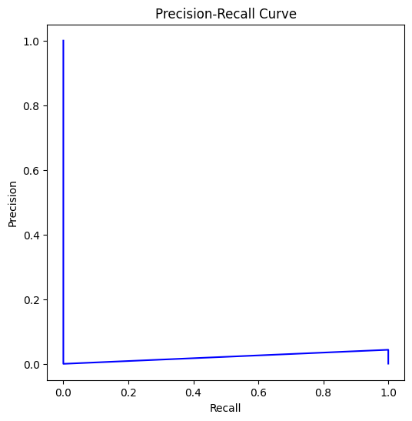
This plot represents the Precision-Recall (PR) curve, which is a crucial metric for evaluating models on imbalanced datasets like fraud detection.

Slide 18
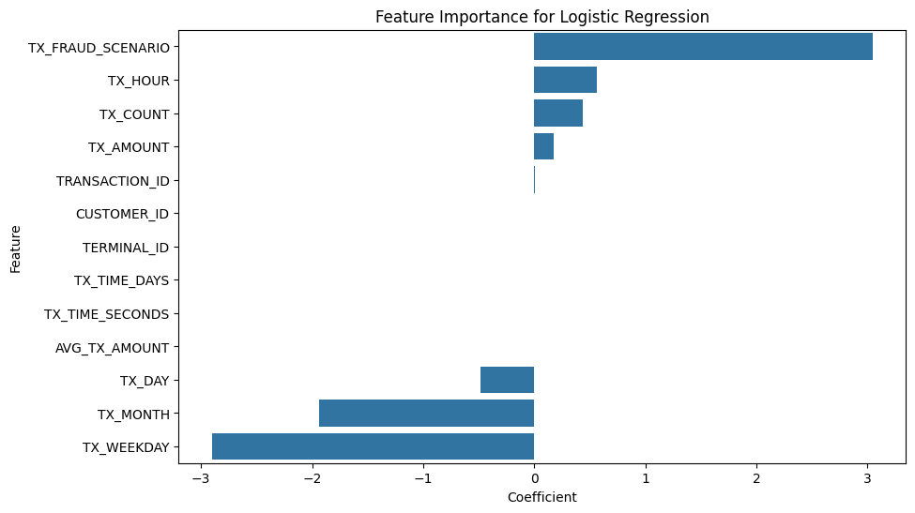
This bar chart represents the importance of different features in a Logistic Regression model for fraud detection. The x-axis shows the coefficient values, indicating how strongly each feature influences the prediction.

Slide 19
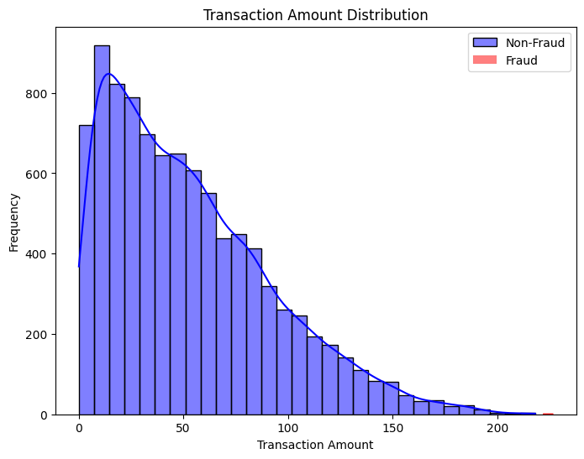
This histogram visualizes the distribution of transaction amounts for both fraudulent and non-fraudulent transactions. Non-Fraud Transactions (Blue Bars): Most transactions are small, with a peak at lower amounts (around 10-50). The distribution gradually decreases as the transaction amount increases. The density curve (blue line) shows a right-skewed distribution, meaning smaller transactions are much more common than larger ones. Fraud Transactions (Red Bars - very few visible): Fraudulent transactions appear to be much fewer in number compared to non-fraudulent transactions. They mostly occur at the higher transaction amounts, though they are still rare.

Slide 20
Conclusion:
Fraudulent transactions are rare compared to non-fraudulent ones, making fraud detection a
highly imbalanced classification problem.
Fraud tends to occur at higher transaction amounts, although the majority of
transactions (both fraud and non-fraud) have lower amounts.
Since non-fraudulent transactions dominate, a model trained without handling imbalance may
predict "non-fraud" most of the time, leading to poor fraud detection.
Feature Engineering Idea: Transaction amount could be an important predictor of fraud, and
techniques like log transformation or outlier analysis may help improve model performance.

